Slide 1
IRB Member Training Session 1: Project Overview, HRPP Toolkit Intro and Crosswalk

Slide 2
Session #1 OBJECTIVES:
Review key process changes and initiatives related to the IRB Efficiency Project
Understand the tools and resources available to IRB members (“HRPP Toolkit”)
Outline expectations for IRB members when reviewing research
Walk-through of the relationship between new tools and templates and the regulatory criteria for IRB approval

Slide 3
Preface:
IRB Member Training & Communication Resources

Slide 4
IRB Member Training
Session 1: HRPP Toolkit overview and crosswalk between templates and reviewer tools
Session 2: Refresher training on the regulatory criteria for IRB approval
Session 3: ARROW update overview and practical walk through of review processes in ARROW using HRPP Toolkit

Slide 5
IRB Member Training
IEP project overview
Delivered in committee meetings by Dr. Conner
Overview of key IRB member questions
Email summary delivered by Lynn Haynes
Additional resources and tools for today’s training:
Training slides (and recordings)
Sample Toolkit materials
“Crosswalk” reference documents

Slide 6
Overview of IRB Efficiency Project Updates

Slide 7
Measures of a Successful HRPP
Compliance – Ensuring that relevant policies, procedures, and practices are consistent with federal, state and AAHRPP requirements.
Efficiency – Managing administrative processes in a way that minimizes turnaround times and reduces unnecessary administrative burdens both for investigators and study team members as well as IRB administrators and members.
Effectiveness – Doing the right things in terms of maximizing customer service levels and enhancing the human research community’s knowledge of human research protections issues.

Slide 8
Some Key Strengths of UW’s HRPP
Culture of compliance and a strong commitment to human research protections
Commitment to continuously improving the quality of the HRPP
High levels of IRB staff "customer service" to support IRB members and UW research community

Slide 9
Opportunities for Improving the UW HRPP
Opportunities to improve overall turnaround time from submission to approval while maintaining regulatory compliance
Opportunities to streamline existing policies and procedures along with certain elements of ARROW system functionality
Desire to maintain high levels of customer service both to the UW research community (in the form of faster turnaround times and streamlined processes) and to the IRB member community (in the form of ongoing support to IRB members in the use of new tools and procedures, establishing greater consistency in committee meeting structure, etc.)

Slide 10
New Process
Process Performed by:
Intake and Admin Review
Pre-Review with redefined summary
Evaluation against Regulatory Criteria for Approval
Committee Determination
IRB Staff: ARROW, Toolkit
IRB Staff: Focus on Completeness, Consistency, Clarity
IRB Members with Staff support
IRB Committee Review & Vote

Slide 11
Summary of Key Programmatic Improvements
Implement HRPP Toolkit
Transition to “Protocol Based Applications” for certain biomedical studies
Transition from “approval ready” to “review ready” approach
Use of worksheets/checklists to supplement IRB member review of review-ready documents
Staff assigned to support a study for the life of the study
Committee scheduling and configuration changes
IRB Committees
IRB Office
Study Teams

Slide 12
UW’s New HRPP Policies and Procedures (HRPP Toolkit)

Slide 13
UW’s HRPP Toolkit - What is it?
UW’s HRPP Toolkit is a comprehensive set of workflows, standard operating procedures, checklists, worksheets and templates:
Implemented by many human research protection programs of all sizes
The HRPP Toolkit was designed with the following concepts in mind:
Maximum regulatory flexibility consistent with compliant procedures;
Easy to follow, non-redundant procedures;
Focus on business process and IRB workflow;
Use of documents to support consistent IRB applications and reviews; and
Support application of ethical principles.

Slide 14
HRPP Toolkit Guiding Principles
Protect subjects
Be compliant
Be efficient
Provide excellent customer service
Simplify workflow
Use the regulatory criteria for approval

Slide 15
HRPP Toolkit Components
SOPs (~37)
Examples: Intake, Pre-Review, Non-Committee Review, IRB Meeting Conduct, Investigations
Worksheets (~23)
Examples: Exempt determination, Criteria for Approval, Emergency Use
Checklists (~15)
Examples: Pre-Review, Non-Committee Review, Children, Waiver of Consent Process
Templates (~38)
Other Resources
Investigator Manual
Human Research Protection Program Plan
Process Maps
Intake Flow Chart
Non-Committee Flow Chart
Convened IRB Flow Chart
Examples: Consent document, Protocol, Minutes, Approval letters

Slide 16
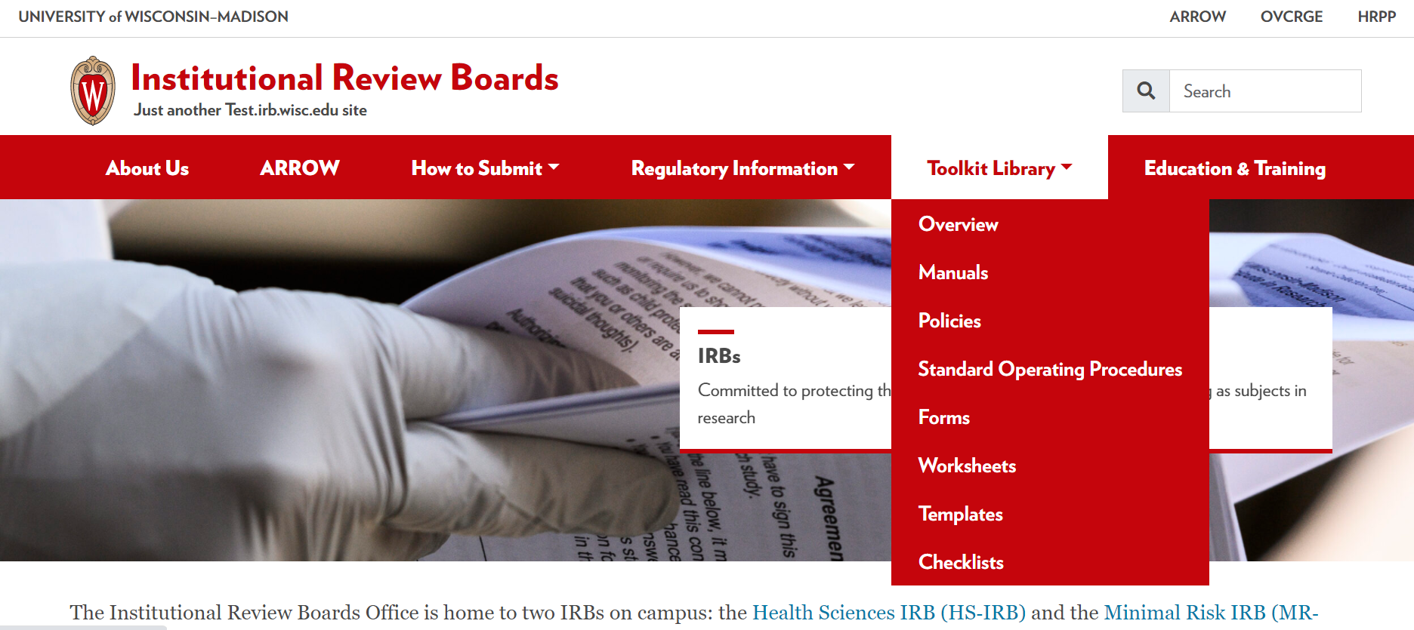
Accessing the HRPP Toolkit…

Slide 17
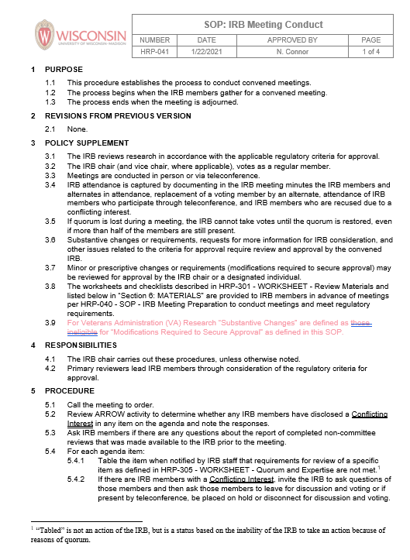
HRPP Toolkit Components
Standard Operating Procedures (SOPs)
Organized by business process (e.g., pre-review, review, post-review) rather than by topic (e.g., continuing review, drugs, and protocol deviations)
Cross-reference worksheets and checklists to be used; does not duplicate information
Most are for IRB staff and committee members, but some are for researchers (e.g. definitions, informed consent process and documentation)

Slide 18
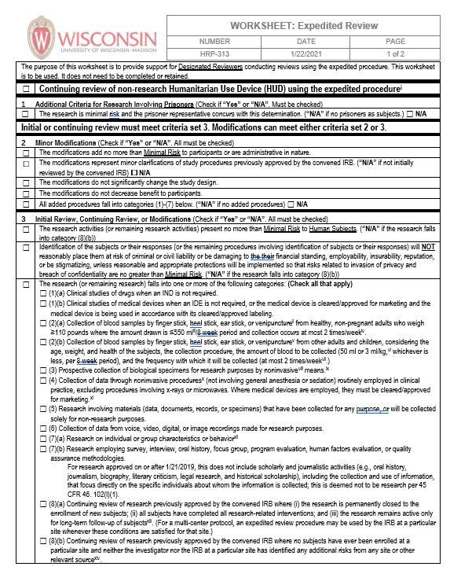
HRPP Toolkit Components
Worksheets
Regulatory decision making that does not need to be documented
Used in review to support decision making but does not need to be completed and kept in the regulatory file
Includes worksheets for topics such as expedited review eligibility, exemption determinations, payments, advertisements, etc.
Used by IRB staff and committee reviewers; accessible to researchers for reference
“Paper-based”

Slide 19
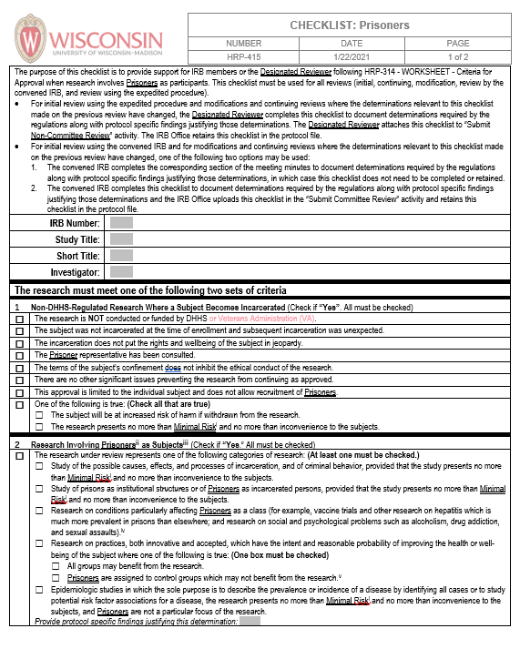
HRPP Toolkit Components
Checklists
Regulatory decision making that must be documented
Need to be completed and kept in the regulatory file
Includes checklists for topics such as research with children (Subpart D), prisoners (Subpart C), adults with impaired decision-making capacity, etc.
Used by IRB staff and committee reviewers; accessible to researchers for reference
Embedded in ARROW for ease of use
(and available in paper form for reference)

Slide 20
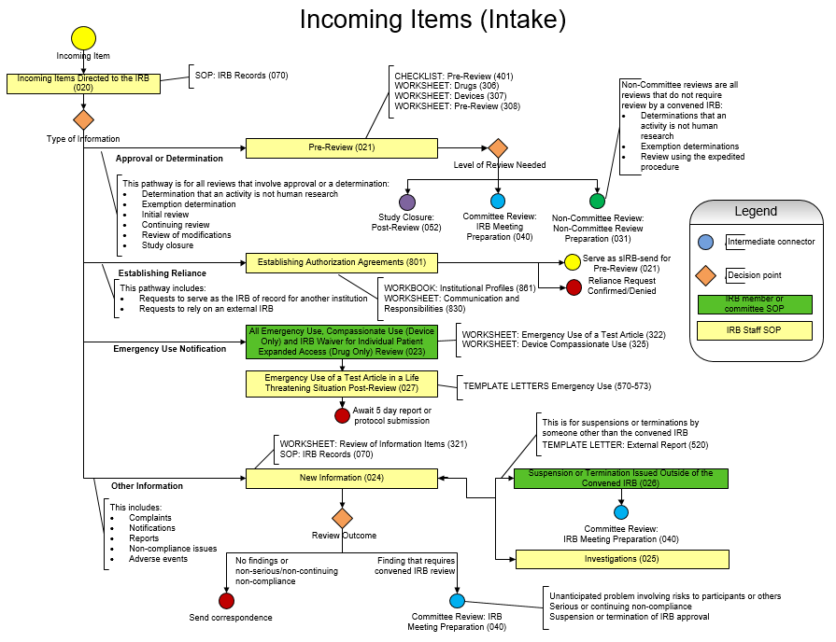

Slide 22
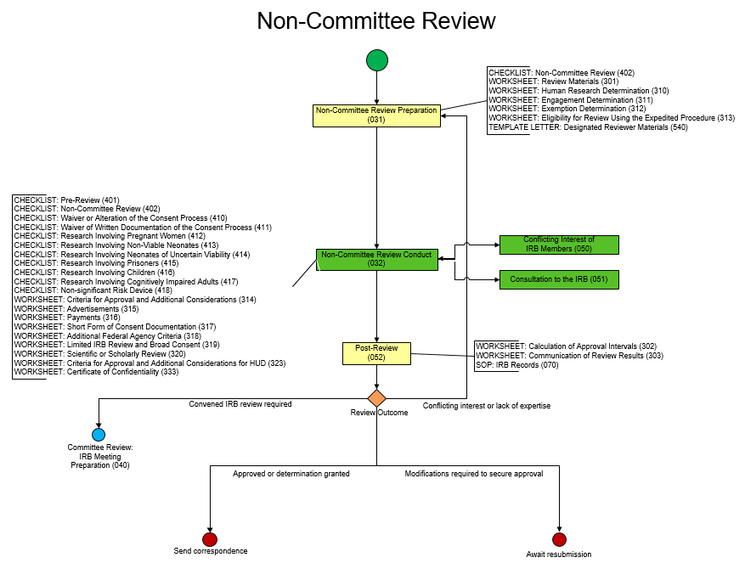

Slide 23
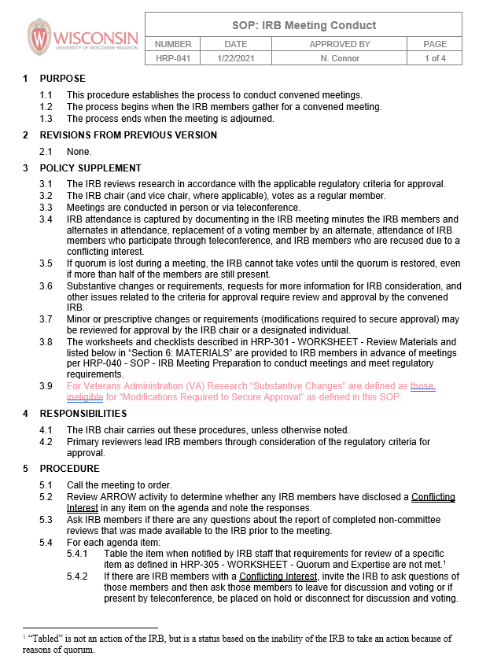
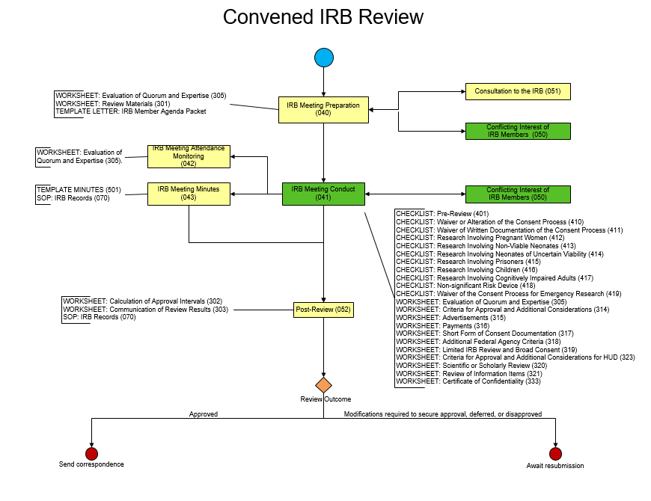
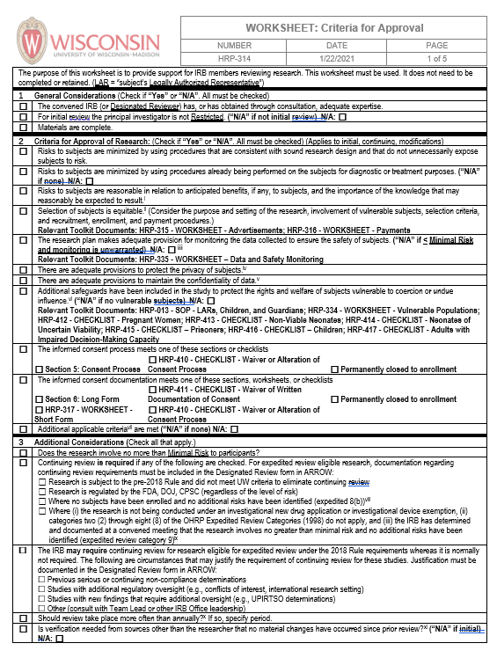
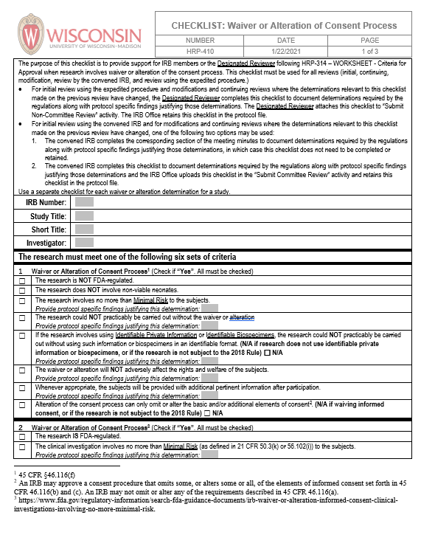

Slide 24
Using the HRPP Toolkit Materials in Practice

Slide 25
IRB review requires an approach that is both systematic and flexible
Ethical decision making is about systematically considering the regulatory criteria for approval
The regulatory criteria for approval derive from the Belmont Principles (respect for persons, beneficence, and justice)
The regulatory criteria for approval contain all rules necessary to protect human subjects
Meet the criteria while balancing the Belmont principles.
The regulatory criteria are full of subjective judgment calls: “reasonable,” “adequate,” “sound,” “equitable,” etc.
This is intentional, recognizing that every study is different, and some flexibility is necessary when performing IRB reviews.

Slide 26
Who needs to review the IRB submission materials?
Chair?
Vice Chair?
Primary reviewer?
Alternate substituting for another members?
Unaffiliated member?
Scientific Member?
Non-scientific Member?
Everyone

Slide 27
What does it mean when you vote to approve research?
Consent Process
(45 CFR §46.116, 21 CFR §50.20, §50.25)
Intro – Consent process
(a) – Required disclosures
(b) – Additional disclosures
(c) – Waiver #1
(d) – Waiver #2
Main Criteria
(45 CFR §46.111/ 21 CFR §56.111)
(a)(1) – Minimization of risks
(a)(2) – Risk-benefit relationship
(a)(3) – Equitable selection
(a)(4) – Consent process
(a)(5) – Consent documentation
(a)(6) – Data monitoring
(a)(7) – Privacy/confidentiality
(b) – Vulnerable subjects
IRB has determined that all regulatory
criteria for approval are met.
Consent Documentation
(45 CFR §46.117, 21 CFR §50.27, § 56.109)
(a) – General
(b)(1) – Long form
(b)(2) – Short form
(c)(1) – Waiver #1
(c)(2) – Waiver #2 (Not FDA)
27
27
Notes:
3/22/2021
27

Slide 28
When do criteria for review apply?
Initial review
Continuing review
Change of protocol
Review of modifications
Review by a convened IRB
Review by the expedited procedure

Slide 29
Considerations for IRB Chairs and Members during IRB meetings
Expect all members to review materials and use the “Criteria for Approval” worksheet (HRP-314) in advance of the meeting.
Review the criteria one at a time (at first…).
Justify every concern or request with a criterion.
Each member votes to approve only if that individual agrees that all criteria are met.
Over time, speed up step 2 (limit focus to criteria that are NOT met).

Slide 30
Crosswalk: Relationships between Template Protocols and the Criteria for Approval

Slide 31
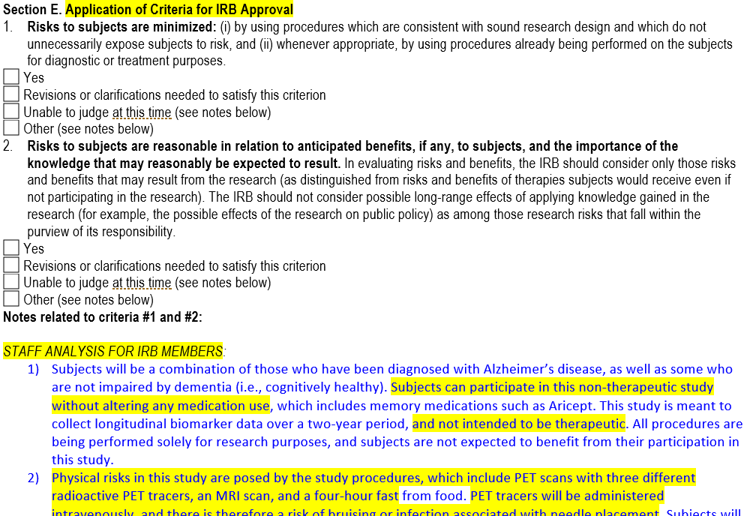
Before, the staff analysis walked through how regulatory criteria were met

Slide 32
Crosswalk: Criteria for Approval
Staff Review
Toolkit Templates
Criteria for Approval
Over the coming weeks and months, we will transition IRB members to review submitted source materials for this information; for example:
HRP-503 – Biomedical Protocol template (PBA)
HRP-502 – Consent Document template
Crosswalk demonstrates where to identify content in the source material for evaluation against 45 CFR §46.111 criteria

Slide 33
NEW: Protocol Templates
Biomedical (referenced in this presentation)
Registry and Repositories
Banking of data &/or specimens for future use
Site Supplement
Multi-site studies where coordinating center is NOT UW
Provides local context missing from non-local protocols such as:
Local standard of care
Plans for sharing results with subjects
Drug & Device Studies?
We will encourage study teams to use the template offered by ICTR

Slide 34
Federal Approval Criteria – Example 1
Federal Approval Criteria 45 CFR 46.111 | Ethical Principles | Study Factors to Consider Corresponds to Sections from HRP-503 - Biomedical Protocol template
Criterion 1(i)(ii): Risks to subjects are minimized through sound design and through re-use of clinical data, when possible | Beneficence | § 2: Background and rationale
 |  | §§ 10-15, 22: Study design: setting, study intervention, timelines, procedures involved, comparison with usual care and study procedures, withdrawal of participants, risks to participants
 |  | § 3: Study objectives and endpoints
 |  | §§ 25-26: Resources available; Multi-site research

Slide 35
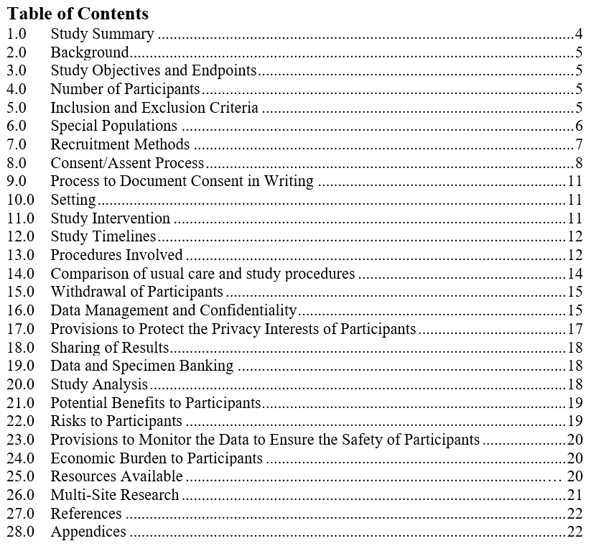
Criterion 1(i)(ii): Risks to subjects are minimized through sound design and through re-use of clinical data, when possible
Crosswalk to HRP-503 – Biomedical Protocol Template
Example 1

Slide 36
Federal Approval Criteria – Example 2
Federal Approval Criteria 45 CFR 46.111 | Ethical Principles | Study Factors to Consider Corresponds to Sections from HRP-503 - Biomedical Protocol template
Criterion 2: Risks to subjects are reasonable in relation to anticipated benefits | Beneficence | Study design sections (see previous) § 13: Procedures involved
 |  | § 21: Potential benefits to participants
 |  | § 22: risks to participants (risks may be physical, psychological, social, economic or legal)
Criterion 3: Selection of subjects is equitable and non-coercive | Justice | §§ 4-5, 7: Number of participants, inclusion and exclusion criteria; recruitment methods and compensation
 |  | §§ 24-25: economic burden to participants, resources available

Slide 37
Criterion 2: Risks to subjects are reasonable in relation to anticipated benefits
Crosswalk to HRP-503 – Biomedical Protocol Template
Example 2
Study Design sections
Potential Benefits to Participants
Risks to Participants
Criterion 3: Selection of subjects is equitable and non-coercive
Number of Participants
Inclusion and Exclusion Criteria
Recruitment Methods & Compensation
Economic Burden to Participants
Resources Available

Slide 38
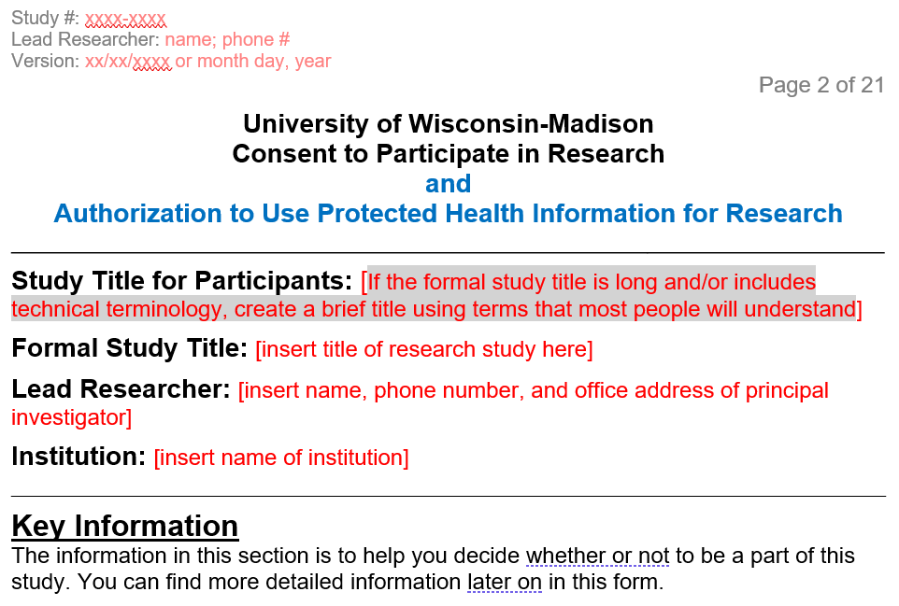
Crosswalk: Informed Consent Elements
HRP-502 – Consent Document template

Slide 39
Informed Consent Elements - Example 1
Basic Consent Elements 45 CFR 46.116 (b), (c) |  | Corresponds to Sections from HRP-502 – Consent Document template
Criterion 1: A statement that the study involves research, an explanation of the purposes of the research and the expected duration of the subject's participation, a description of the procedures to be followed, and identification of any procedures that are experimental |  | Key information section Why are the researchers doing this study? What will I need to do in this study? What is being tested? Does it involve randomization? How long will I be in the study? Detailed Information: If I take part in the study, what will I do? Optional study activities

Slide 40
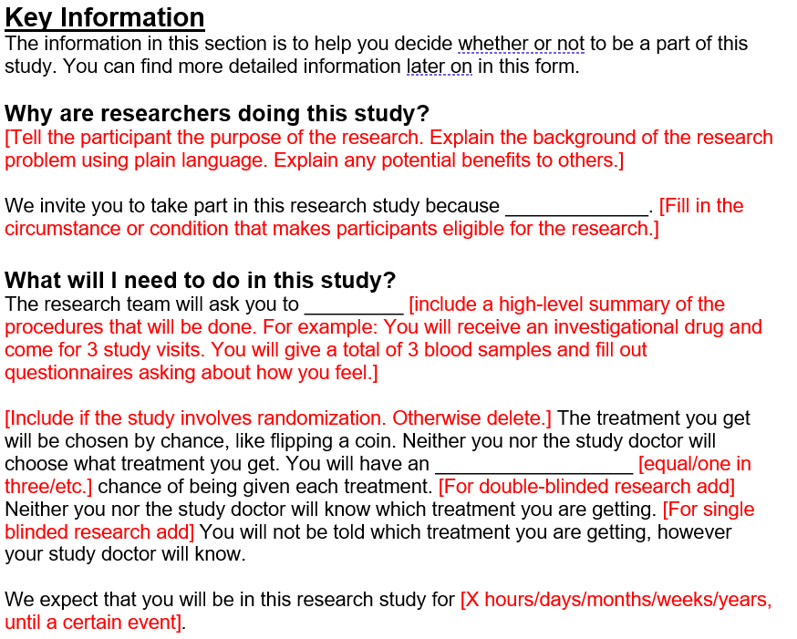
Crosswalk to HRP-502 – Consent Document template
Example 1
Criterion 1:
A statement that the study involves research, an explanation of the purposes of the research and the expected duration of the subject's participation, a description of the procedures to be followed, and identification of any procedures that are experimental

Slide 41
Informed Consent Elements – Example 2
Basic Consent Elements 45 CFR 46.116 (b), (c) |  | Corresponds to Sections from HRP-502 – Consent Document template
A description of any reasonably foreseeable risks or discomforts to the subject |  | Key information section: What are some reasons I might not want to be in this study? What are the study risks? For DoD personnel: any risk to fitness for duty or loss of access/duty

Slide 42
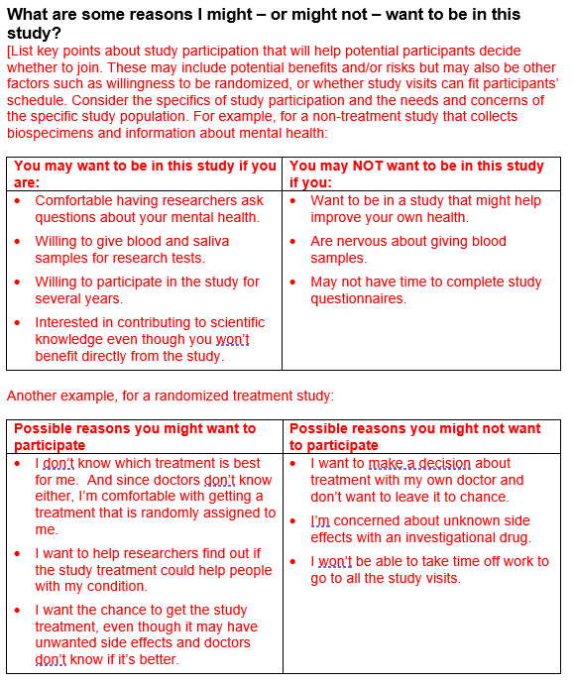
Crosswalk to HRP-502 – Consent Document template
Criterion 2:
A description of any reasonably foreseeable risks or discomforts to the subject
Example 2: Key Information

Slide 43
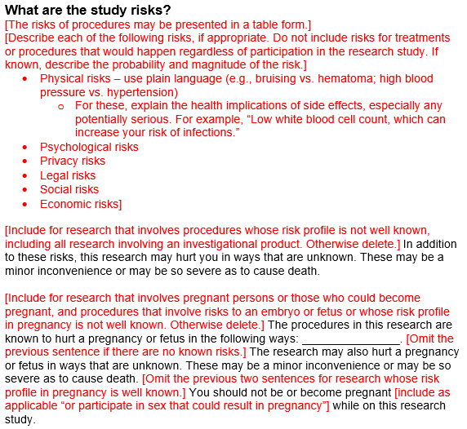
Crosswalk to HRP-502 – Consent Document template
Criterion 2:
A description of any reasonably foreseeable risks or discomforts to the subject
Example 2: Detailed Information

Slide 44
Questions?

Slide 45
IRB Member Training: Coming Soon…
Session 2: Refresher training on the regulatory criteria for IRB approval
Recorded training
Session 3: ARROW update overview and practical walk through of review processes in ARROW using HRPP Toolkit
Live sessions and recorded training

Slide 46
Appendices

Slide 47
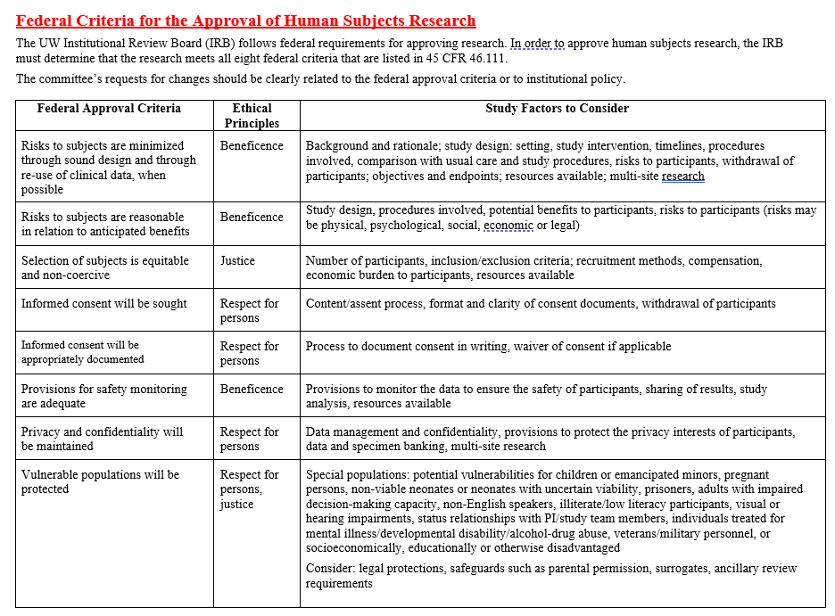
Appendix A

Slide 48
Appendix B
Pg 1 of 2

Slide 49
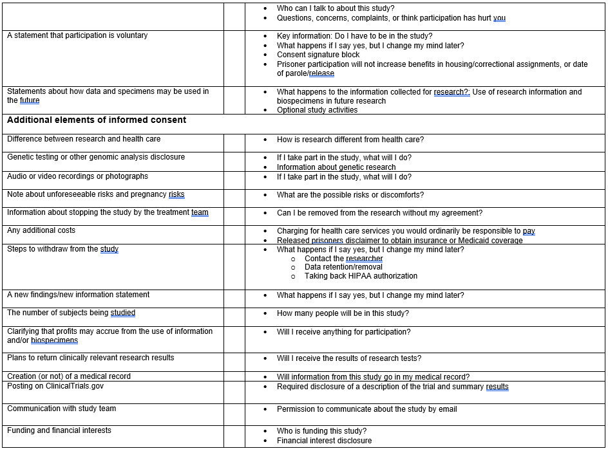
Pg 2 of 2

